Slide 1
C programming Review
Lecture 2

Slide 2
Introduction
Variable
Conditional statements
Iteration (while, for….)

Slide 3
Declare Variables
A variable is a location in memory that is most frequently referred to by its name, it can store a value of particular data_type and it has an address and can also be referred to by its address.
Variable must be declared before they can be use; the format is
data_type variable_name; e.g. int var1

Slide 4
Format specifiers for printf.
There are quite a number of format specifiers for printf. Here are the basic ones :
%d print an int argument in decimal
%ld print a long int argument in decimal
%c print a character
%s print a string
%f print a float or double argument
%p print the value of a pointer in its hex format
%u print an unsigned interger (positive numbers)

Slide 5
Input/ output
There are numerous ways to input data via the keyboard:
scanf(“%d”, &input) (explain this code)
fgets(ArrayName, Array_Size, stdin): gets can cause problems
There are numerous was to output data (to screen):
printf(“ the value of the input is: %d”, input);
putchar(input);
puts(input);
It is important to remember that you write a program two sets of people the end user and a programmer:
For an end user: “appropriate user/interface; e.g. prompt/output….” ;
For the programmer what is the code doing?

Slide 6
Conditional Statements
A conditional statement?
Relational expressions
Has two parts: Operands and operator
5 > 3; 5==3; 5 == 5;
Returns a Boolean value: true/false
Boolean operators
Has two parts: Operands and operator
The three basic operators are: AND (&&); OR (||) and NOT (!)
Returns a Boolean Value

Slide 7
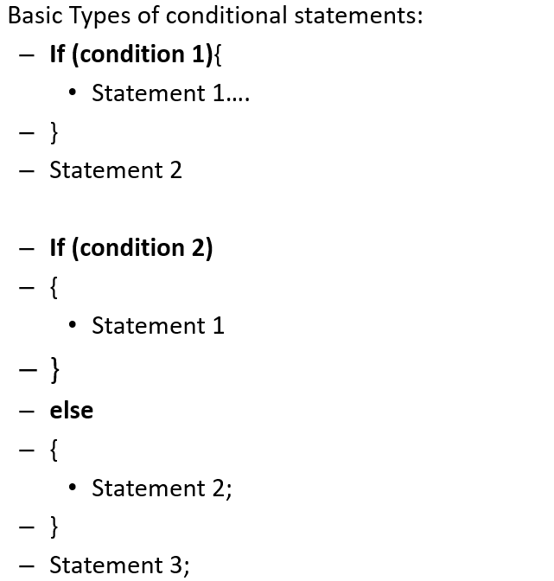
Conditional Expressions
If condition 1 is true what is the output?
If condition 1 is false what is the output?
If condition 2 is true what is the output?
If condition 2 is true what is the output?

Slide 8
Iteration statements
What is the purpose of iteration statements?
Main types of Iteration statements are:
while ; do while and for loop:
When should you use them?
Sentinal and counter control?
Differentiate between them.
The 3 Important steps associated with iteration statements:
Initalise conditional variables,
write conditional expression ;
change a variable in the conditional expression

Slide 9
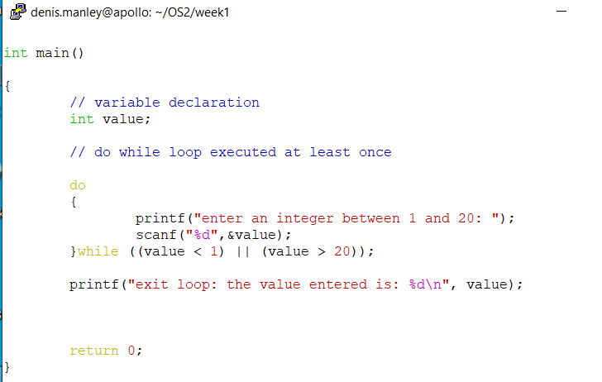
What is the purpose of the following code?

Slide 10
What is the purpose of the following code?

Slide 11
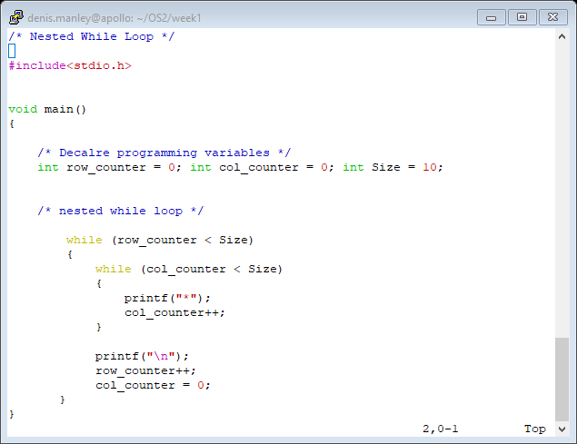
a) What is the output of the following code?
b) What would happen to the code if col_counter = 0 is removed/commented out?

Slide 12
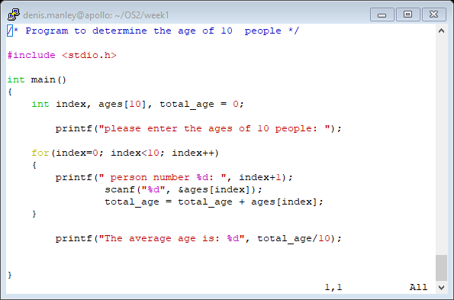
Arrays: static data structure

Slide 13
Compile and run a program in linux
Use the gcc compiler
To compile (go to directory where program is stored: using cd)
gcc –o exe_file name c source file name
To run the program
./exe file

Slide 14
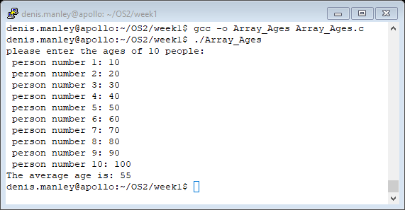
Array example: compile and run
Does the program produce the correct output?

Slide 15
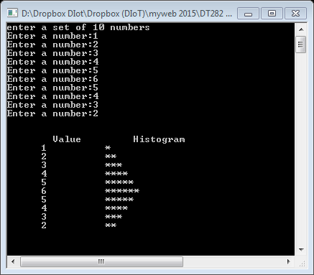
Week 1 Homework: Histogram
Write an algorithm and a c program to
prompt the user for 10 numbers and store these in an array.
The numbers in the array are then processed to graph the information in
the form of a bar chart or histogram - each number is printed, and then
a bar consisting of that many asterisks is printed beside the number .
The following is a sample of the expected output:

